Slide 1
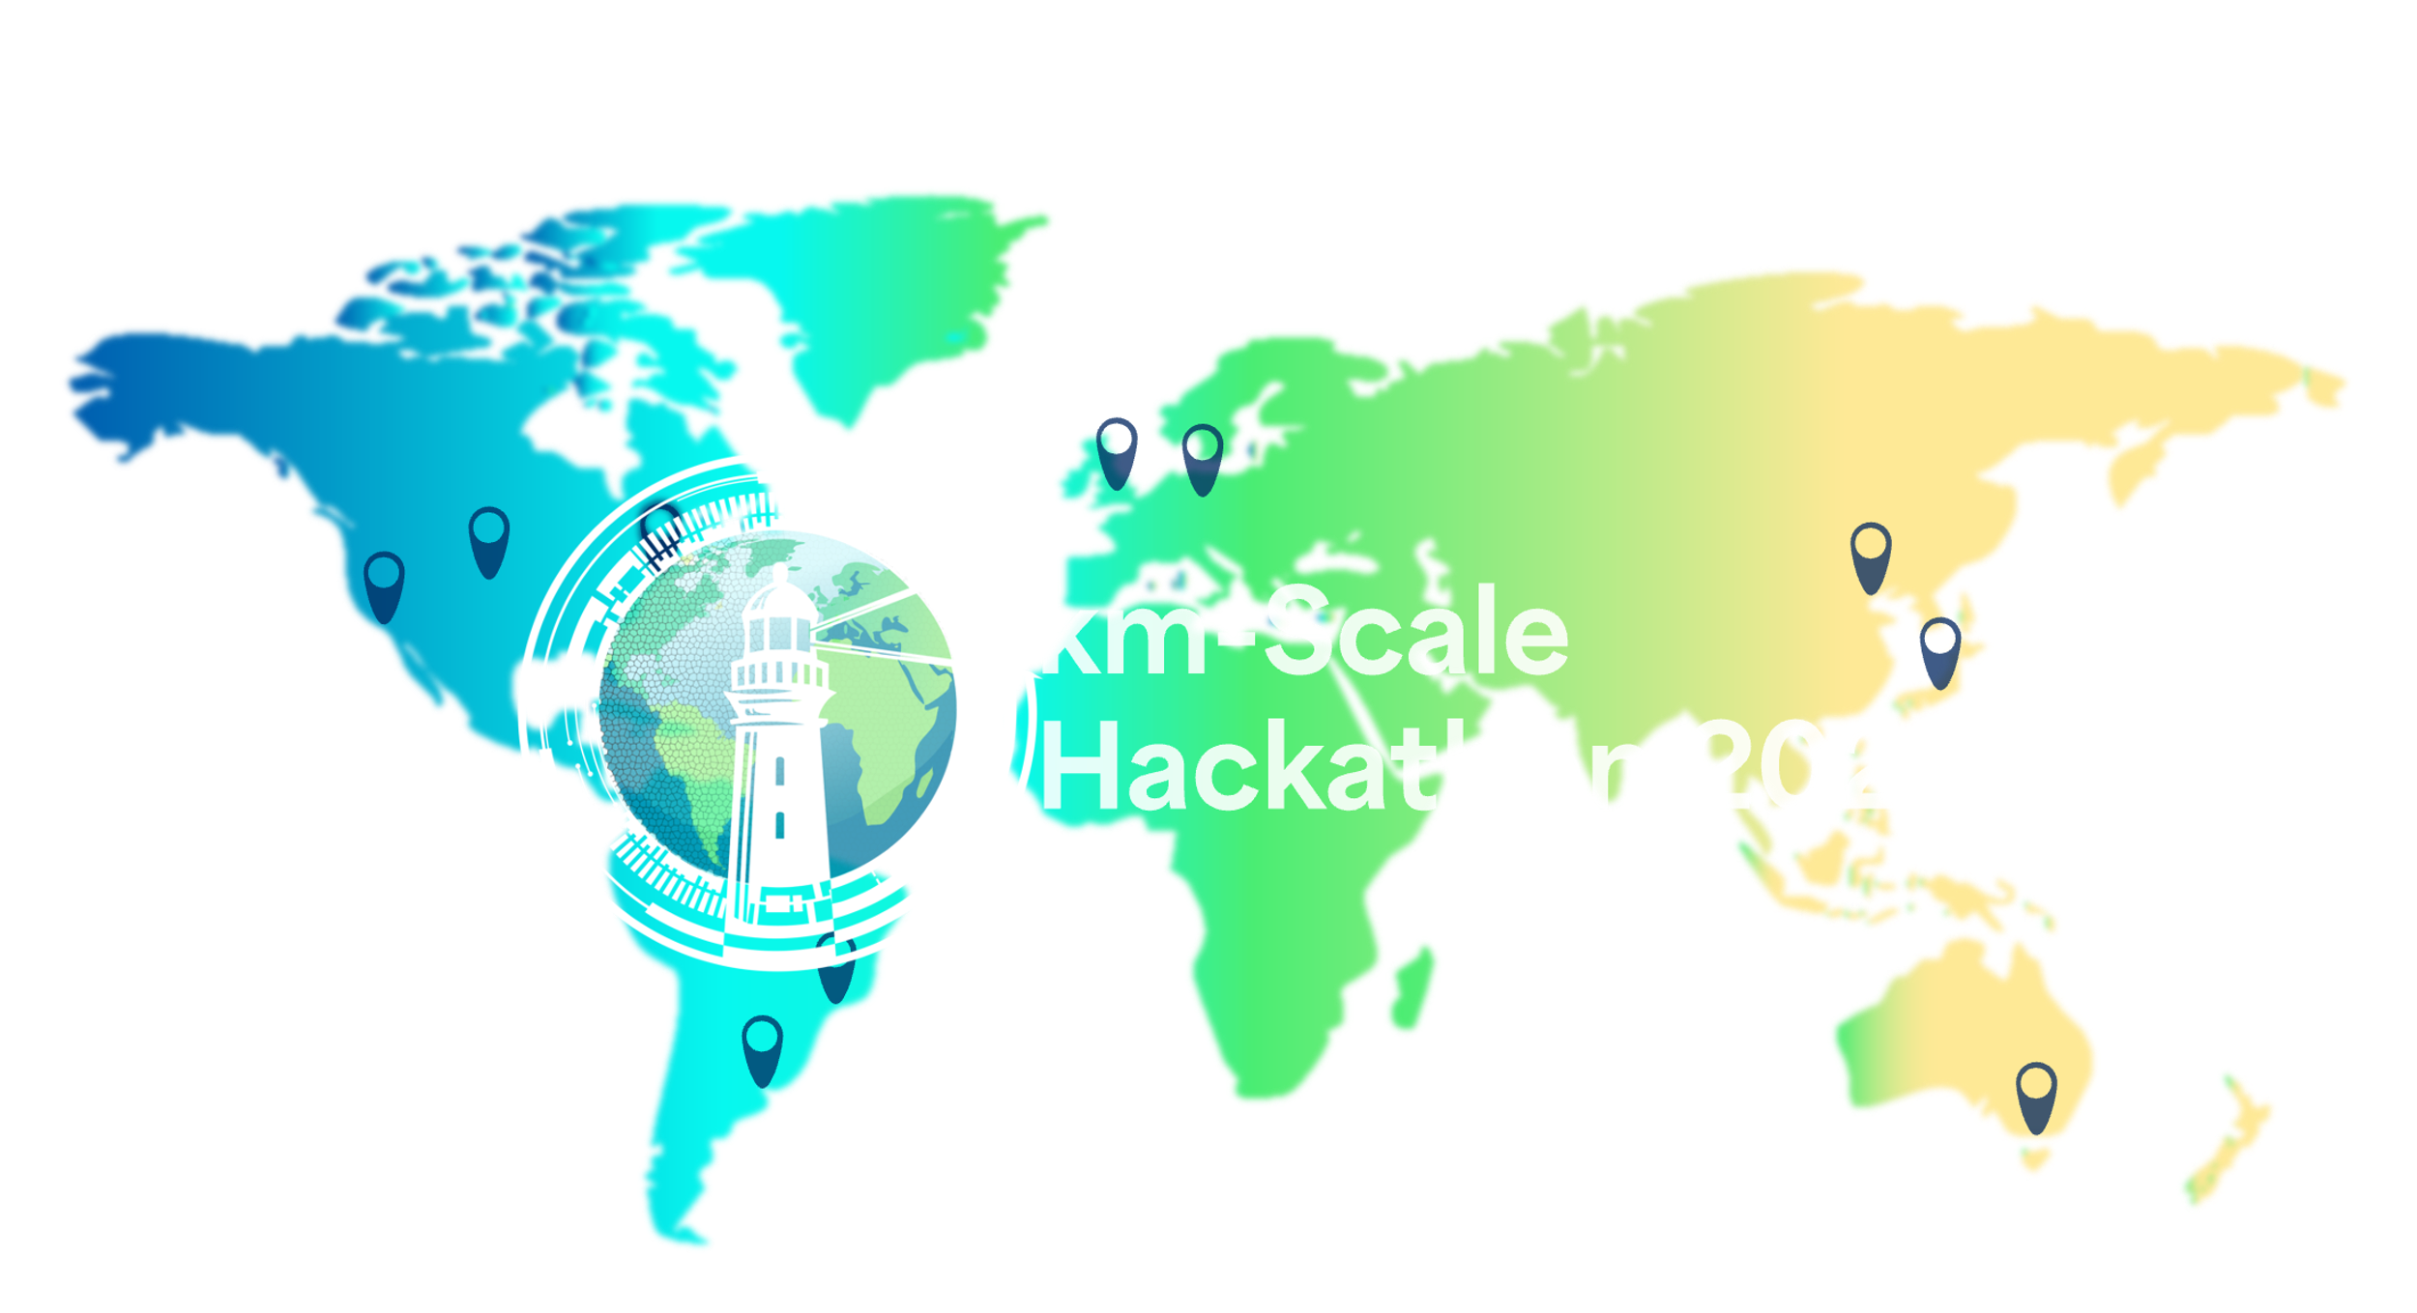



The World Climate Research Programme Global KM-scale Hackathon
12th to 16th May 2025 in Tokyo
Team Tropical Cyclone
Sho Arakawa, Xu Chen, Hsin-Chien Liang, Leia Pauline S. Tonga, Haru Shinoda, Yutaro Nirasawa,
Chieh Ting Tsai, Emmanuel Rongmie, Liu Zhenrong, Yohei Yamada, Marguerite Lee, Koki Iida,
Junshi Ito, Aihisa Kamijo

Slide 2
Data and Method Description
NICAM
ICON
IFS
 | NICAM | IFS | ICON
Experiment Name | nicam_gl11 | ifs_tco3999-ng5_rcbmf | icon_d3hp003
Period | 2020/03-2021/02 | 2020/03-2021/02 | 2020/01-2021/02
Type | Atmosphere-only | Fully coupled | Atmosphere-only
Tropical cyclone Detection Criteria (Tempest-Extreme)
Glboal Domain
minima in SLP, and a closed contour criterion is applied, requiring an increase in SLP of at least 2hPa within 5.5。
decrease in geopotential height difference (300–500 hPa) of 6 m within 6.5。
a maximum distance between candidates of 8。, consisting of at least 10 candidates per

Slide 3
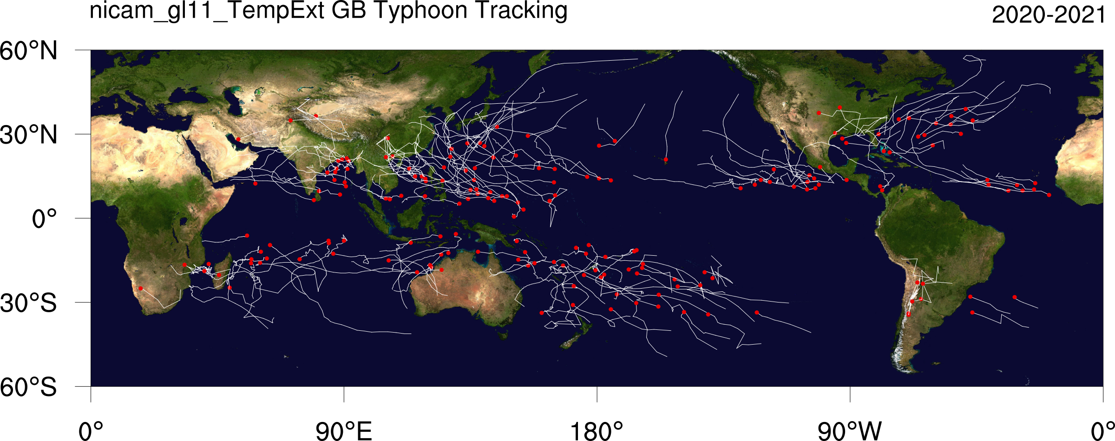
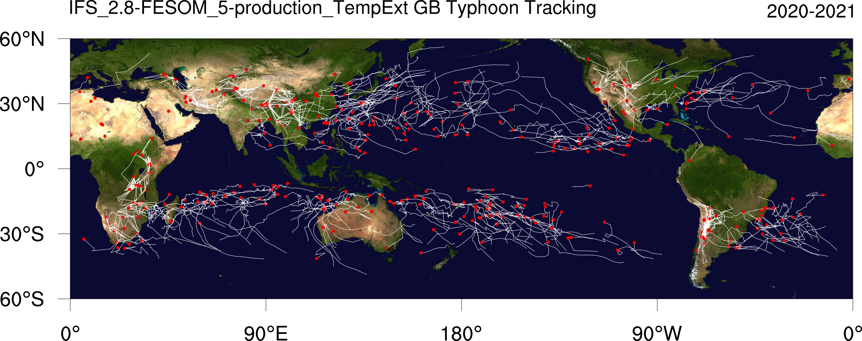
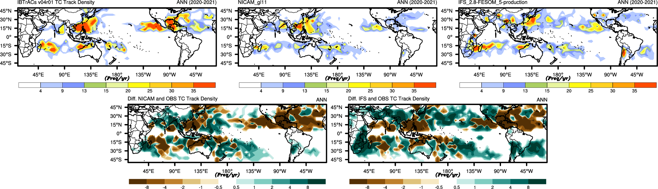

Slide 4
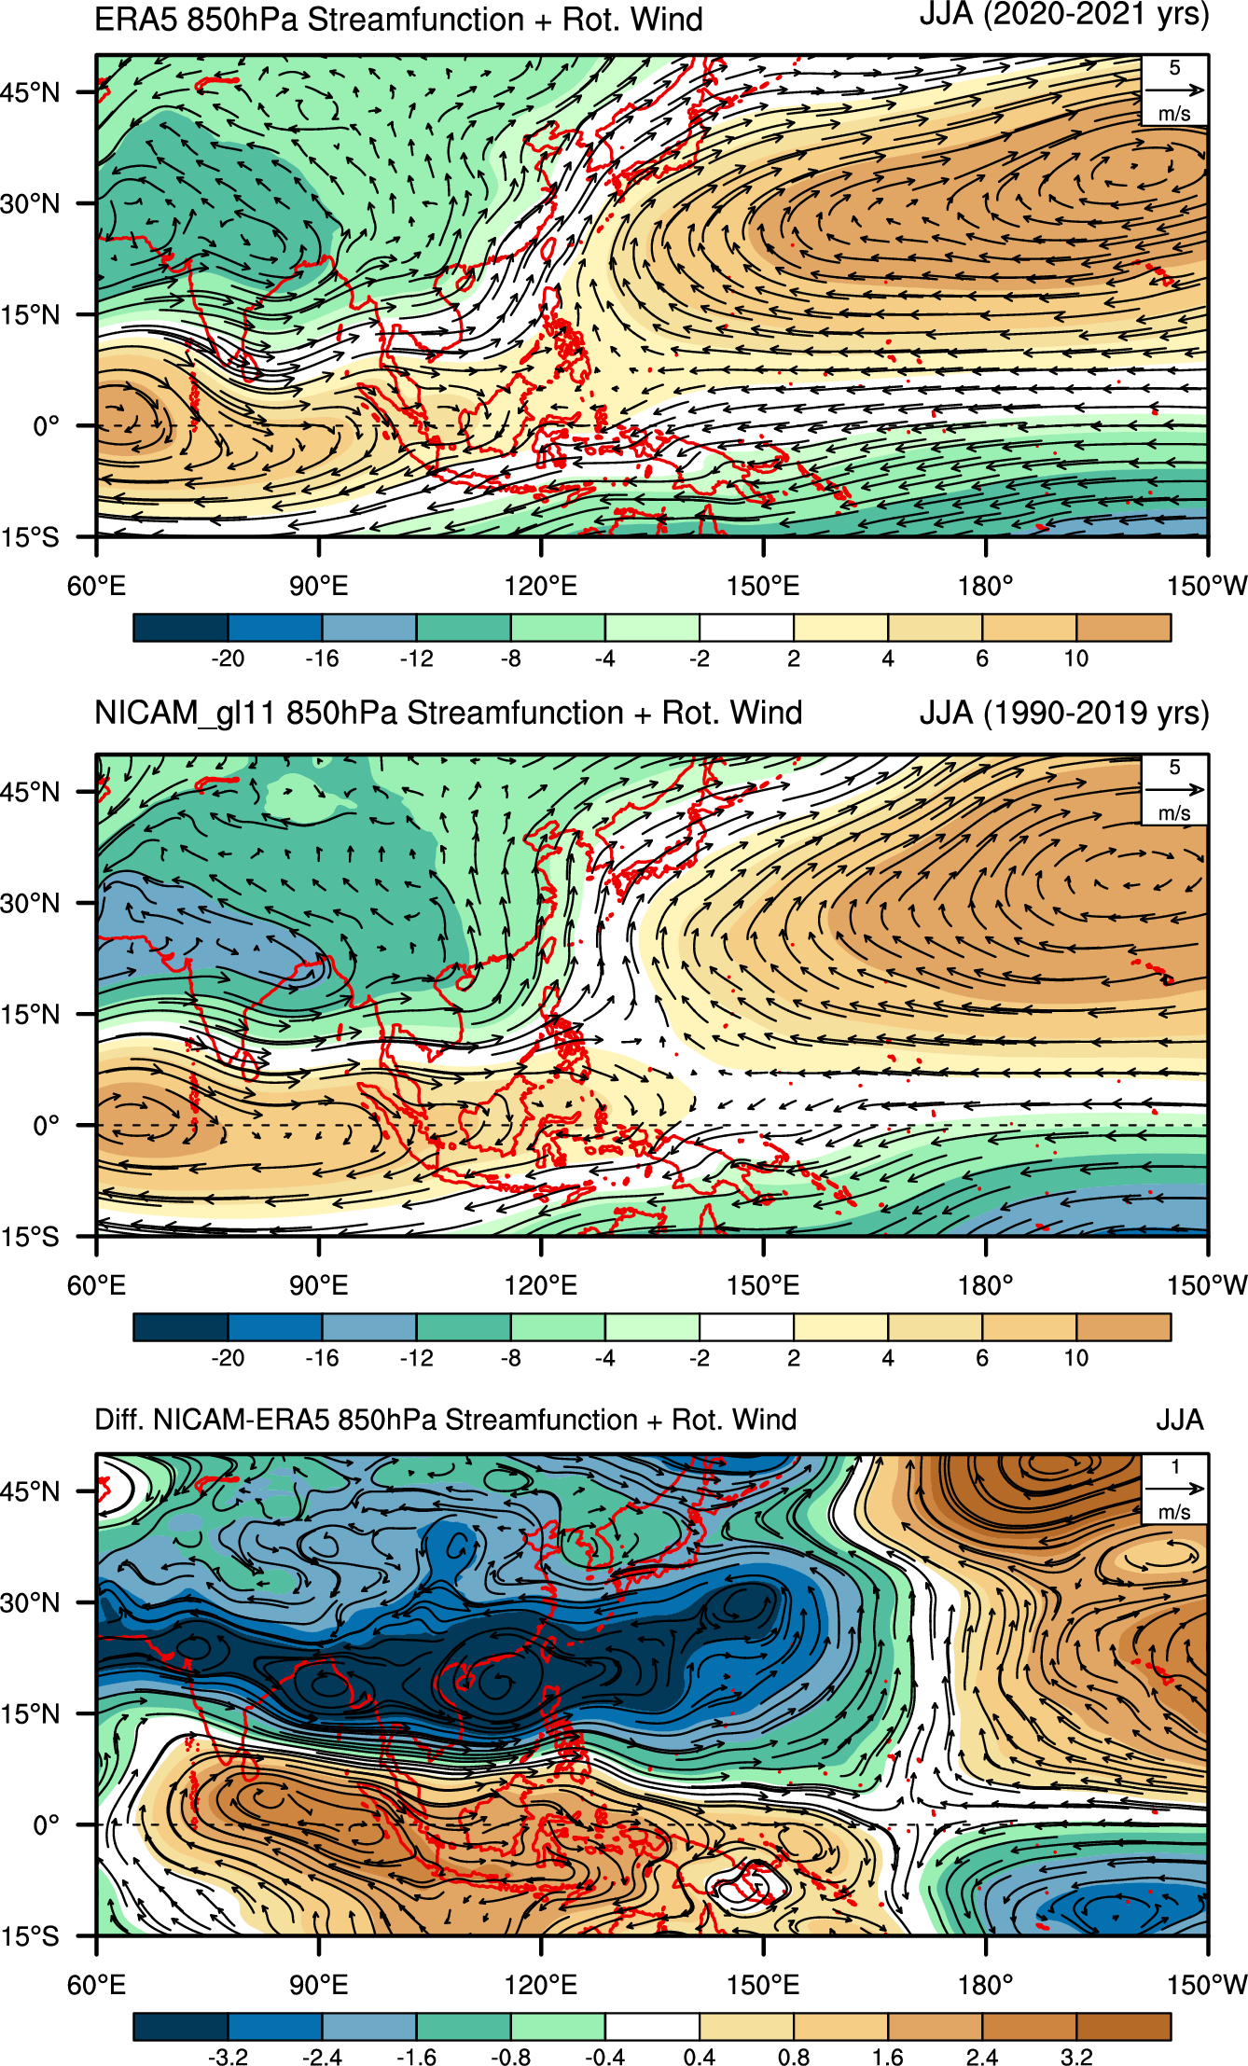
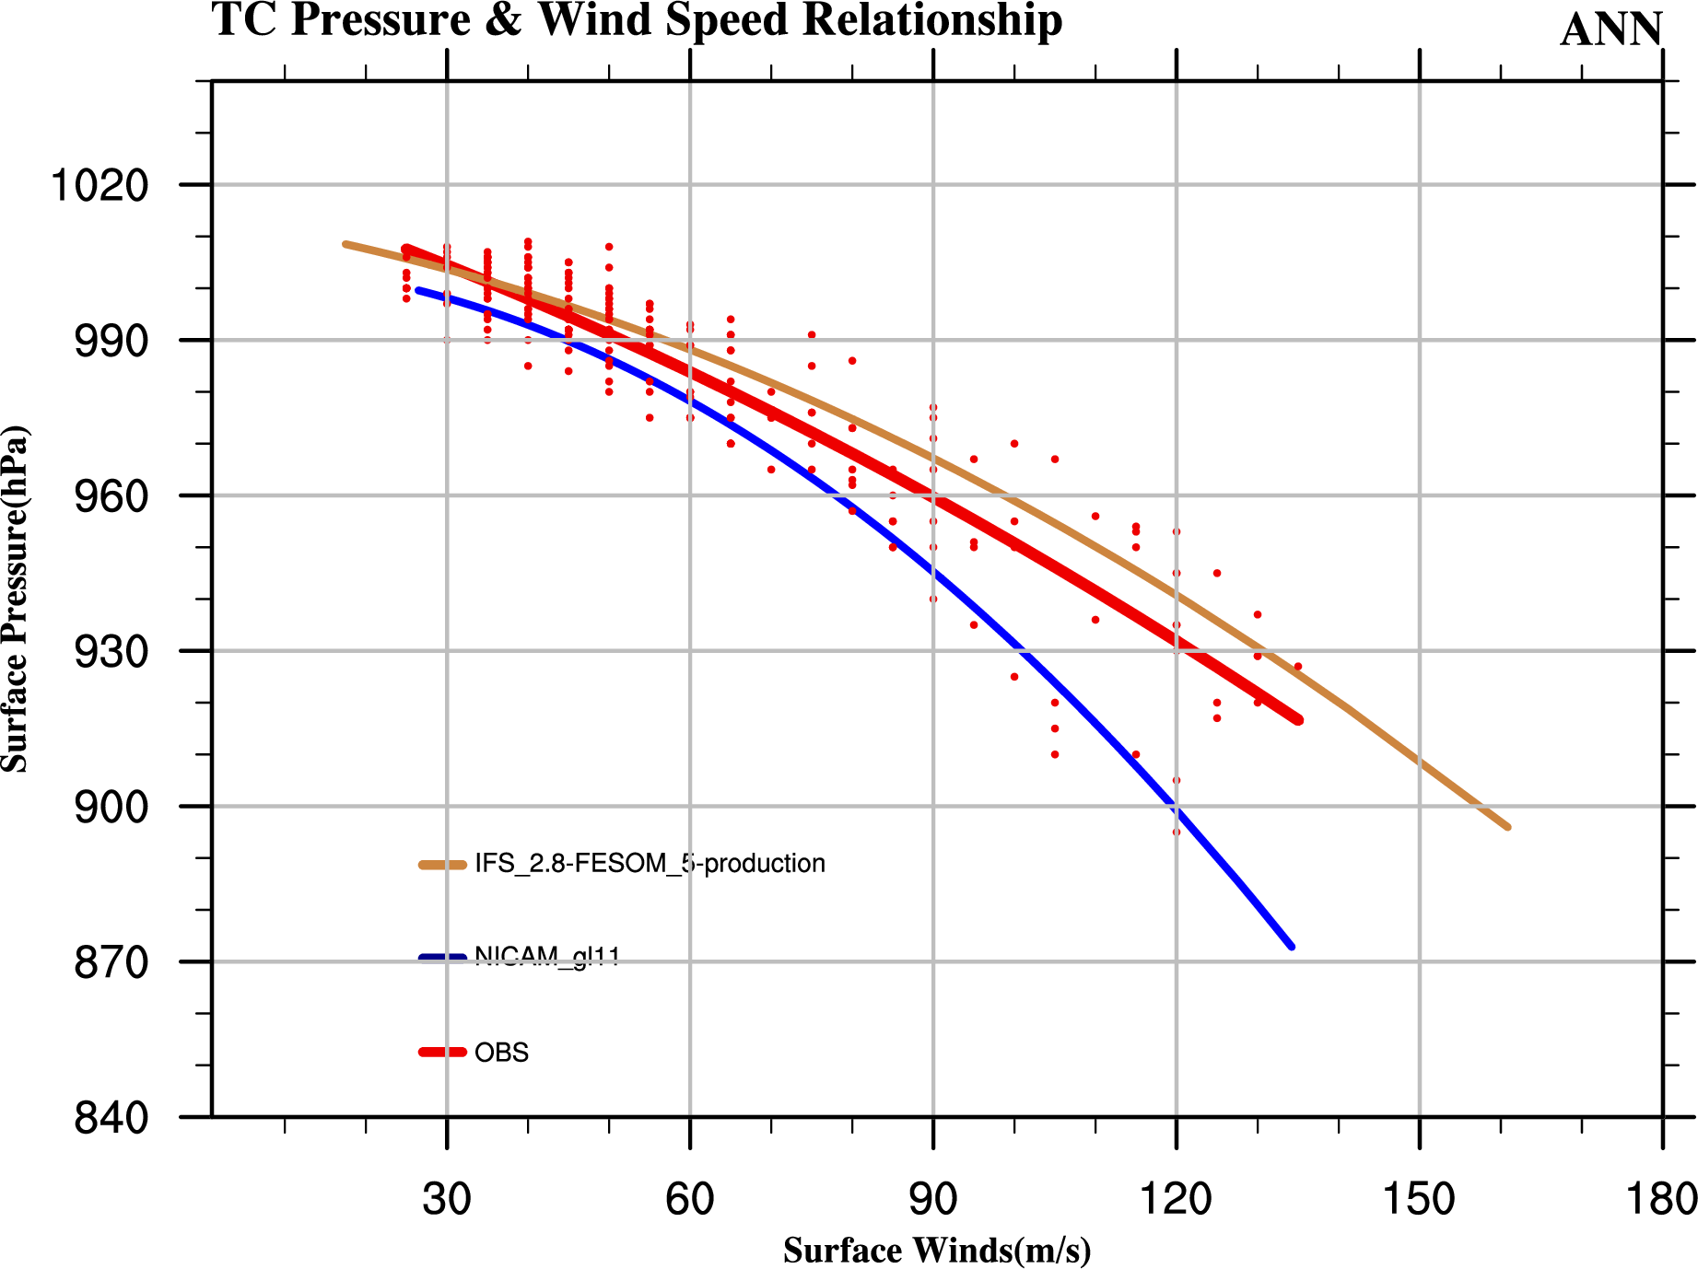

Slide 5
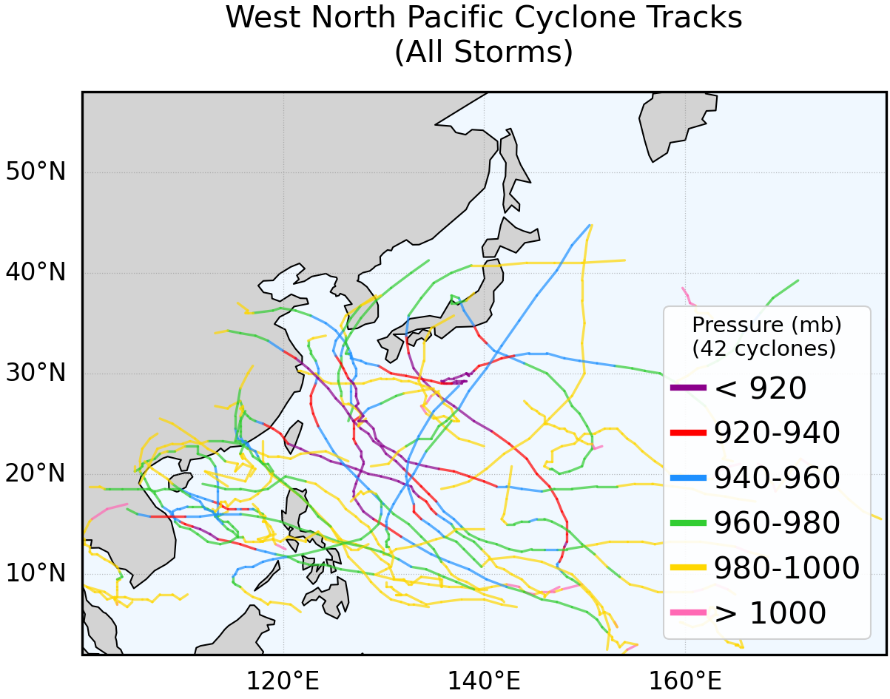
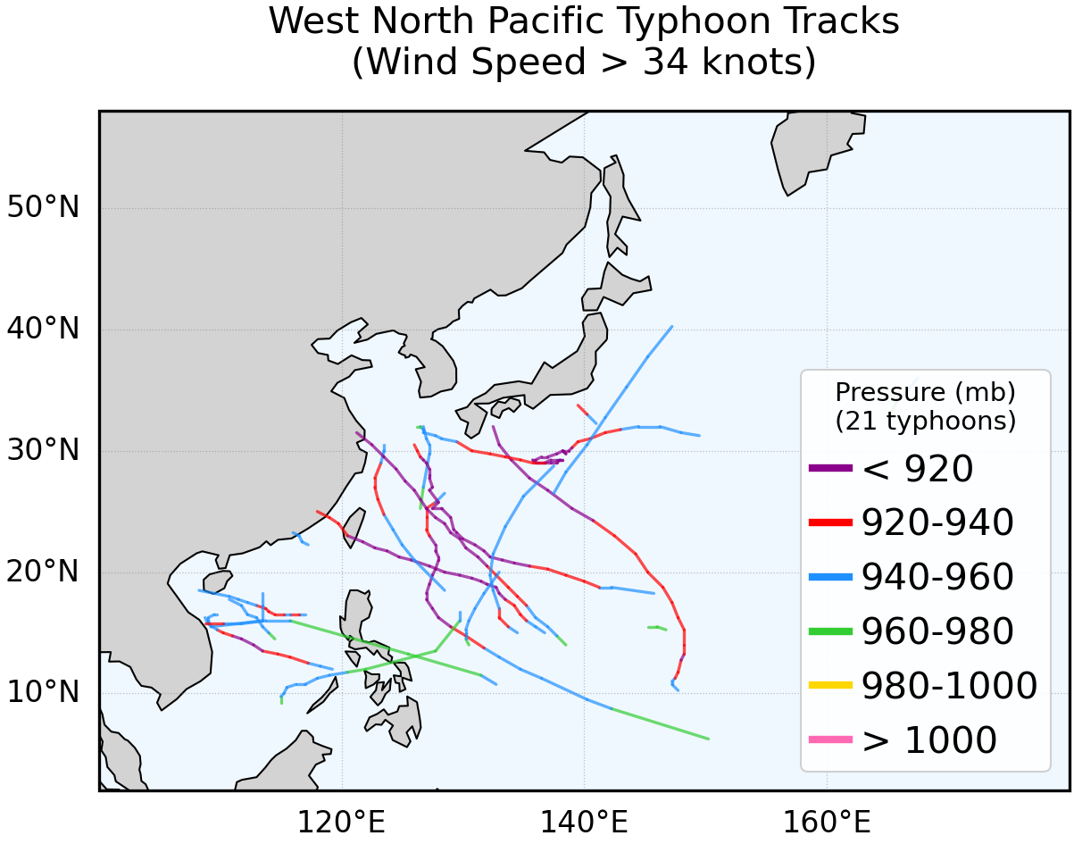
Tracks of Typhons over West North Pacific
Future DATA: ICON IFS
GFDL Tracks of all systems over West-North Pacific(WNP) which is ≥ 17 knots.
GFDL Tracks of all systems over WNP which is ≥34 knots.
Outcomes **About 42 storms are detected which did not evolve into Typhoons(Non-developed). **About 21 storms are detected which evolve into Typhoons (Developed).
Future work (Things to Ponder !!)
Tracking with Tempest Tracker and newly developed tracker for detection of seeding time. Will try to understand physical processes between non developing and developing typhoons.
NICAM-MODEL

Slide 6
Future work
Detection of heat waves associated with tropical cyclone landfall
Calculus the Rapid Intensification about typhoon.
Analysis TCs vertical structure
Intercomparison between multi-model result.
understand physical processes between typhoons.

